Slide 1
Damped simple harmonic motion
28th August 2018

Slide 2
Phase space
In classical mechanics, the phase space is the space of all possible states of a system; the state of a mechanical system is defined by the constituent positions and velocities or momenta.
A plane of position vs velocity is a phase space for a single particle whose motion is restricted to lie along a single spatial coordinate.
The future state of motion of such a particle is completely specified if its positon and velocity are know simultaneously.
The trajectory of these points in phase space represents the complete time history of the particle.

Slide 3
Simple harmonic oscillator : no damping force
A general solution for simple harmonic motion may be written as
The corresponding velocity is found to be
The trajectory of the oscillator in the phase space becomes
The motion repeats itself, a consequence of the conservation of the total energy of the harmonic oscillator.

Slide 4
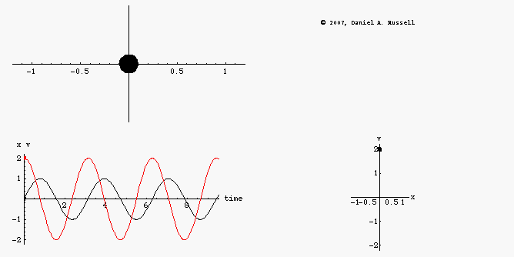
Phase space diagram for undamped oscillator
An object undamped oscillating back and forth along x axis
Position x(t) (leads/lags) velocity v(t) by …..rad
The phase diagram plot (phase space) is a combined plot of x(t) and v(t) giving a clockwise ellipse.
http://www.acs.psu.edu/drussell/Demos/phase-diagram/phase-diagram.html
Notes:
Position x(t) lags velocity v(t) by 90 degrees

Slide 5
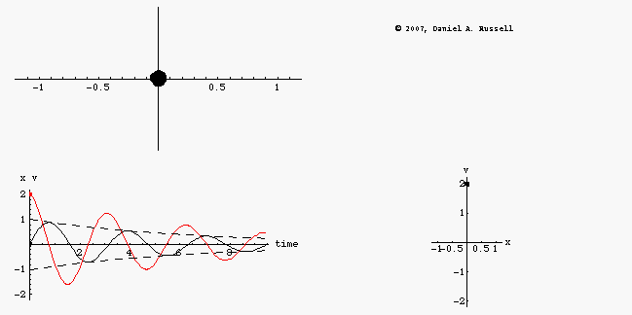
Phase space diagram for damped oscillator
The oscillator loses energy during each cycle.
x(t) and v(t) exponentially decrease in amplitude as time proceeds.
In classical mechanics, this phase space described as an "attractor" .
http://www.acs.psu.edu/drussell/Demos/phase-diagram/phase-diagram.html

Slide 6
Damped simple harmonic motion
Equation of motion
General solution for the differential equation
Where t = time and C₁, C₂ are arbitrary constants.

Slide 7
Three possible conditions
(1) Heavy damping :
(2) Critically damping:
(3) Lightly damping:
Notes:
Heavy damping = supercritical damping, overdamping

Slide 8
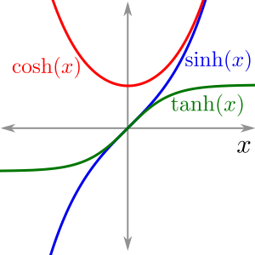
Heavy damping
To illustrate the behavior of the heavy damping (over damping), the displacement x(t) can be rewritten as
Where
This represents non-oscillating behavior.
http://calculus.seas.upenn.edu/?n=Main.ComputingTaylorSeries
Notes:
The motion is an exponential decay with two different decay constants, (p+q) and (p-q).
The oscillation is prevented by the strong damping force.
There is no trace of oscillatory motion.
Cosh z = (1/2)(e^z + e^-z)
Sinh z = (1/2)(e^z -e^-z)

Slide 9
Heavy damping graph
Given an initial condition x(t=0) = 0.
The displacement x(t) is written as
x(t) = ………………………………….
The graph returns to zero displacement quite slowly without oscillating about its equilibrium position.

Slide 10
Critically damping
Under the critically damping, the displacement becomes
Where A is a constant length and B is a given velocity which depends on the boundary conditions.
Suppose a critical damping system
has zero displacement at t = 0 and receives
an impulse which gives it an initial velocity V.
Determine the maximum displacement.
Also the motion is nonoscillatory.
Notes:
Using given initial conditions, A = 0 and B = V.
Then use dx/dt = 0 to determine time t corresponding to the maximum displacement.
Substituting the calculated t to determine the maximum displacement.
The maximum displacement is found to be xmax = 0.368V/p

Slide 11
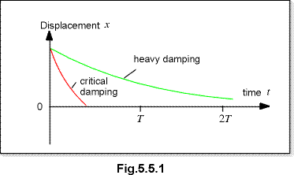
Comparison between heavy damping and critical damping
Heavy damping of a damped oscillator will cause it to approach zero amplitude more slowly than for the case of critical damping.
Critical damping is of practical importance in mechanical oscillators which experience sudden impulses and required to return to displacement in minimum time.
Notes:
Overdamping of a damped oscillator will cause it to approach zero amplitude more slowly than for the case of critical damping. The damping coefficient is greater than the undamped resonant frequency .

Slide 12
Lightly damping
The behavior of the lightly damping oscillating system is described by
The amplitude of the oscillator decays exponentially with time according to
The damping coefficient r controls how fast the oscillating system comes to rest.

Slide 13
Analysis of the lightly damping displacement
Referring to
The bracket has the dimensions of frequency and can be written as
and ω = frequency of ideal simple harmonic frequency (no damping!)
Therefore, ; provided that
A and φ are constants which depend on the motion at t = 0.
This lightly damping oscillation can then be compared to the simple harmonic oscillation.
Notes:
โดยสรุปคือใน slide นี้เราต้องการจัดรูป x(t) เป็น harmonic function ซึ่งถ้าจัดได้แสดงว่า displacement มีการแกว่งไปมารอบจุดสมดุล
ทำได้สองทางคือ
เริ่มจากการที่ต้องการ displacement เป็นจำนวนจริง ซึ่งจะเป็นจริงได้ก็ต่อเมื่อ C1 และ C2 เป็น complex conjugate ซึ่งกันและกัน และค่า C1, C2 กำหนดให้ตามที่เห็นใน slide
2. อาศัย boundary conditions ที่ t =0 ให้ x = Asinφ โดยที่ A และ φ เป็นค่าคงตัว เมื่อให้ t = 0 จะได้ว่า x(t =0) = Asinφ = C1 + C2 เมื่อ ค่า C1, C2 กำหนดให้ตามที่เห็นใน slide

Slide 14
Differences between the undamped oscillation and underdamped oscillation
Recall, the undamped oscillatory displacement :
The underdamped oscillatory displacement :
There are two difference : (1) the presence of the real exponential factor leading to a gradual death of oscillations and (2) the underdamped oscillator’s angular frequency.
The underdamped oscillator vibrates a little more slowly than does the undamped oscillator.
The period of underdamped oscillator is given by

Slide 15
Energy Consideration
The total energy of the damped harmonic oscillator is given by
Differentiate the total energy with respect to t :
From the equation of motion of the damped oscillation :
The time rate of change of total energy is found to be the product of the damping force and the velocity
Because this always either zero (undamped) or negative (underdamped), the total energy continually decreases.
Notes:
dE/dt = the rate of energy loss

Slide 16

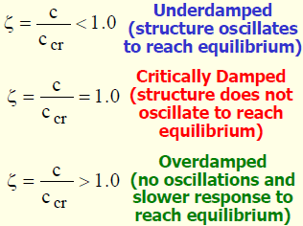
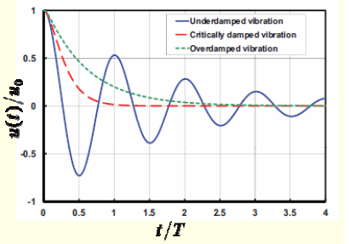
Damping ratio
Damping Ratio is dimensionless parameter which describes how an oscillating or vibrating body comes to rest.
https://www.quora.com/What-is-damping-ratio

Slide 17
Values for describing the damping of an oscillator
Three different values are used to describe the damping of an oscillator.
They are composed of (1) Logarithmic decrement, (2) Relaxation time and (3) Quality Factor or Q-Value.
The exponential decay factor exp(-rt/2m) expresses the rates at which the amplitude and energy is reduced.

Slide 18
Logarithmic decrement (1)
This value represents the rate at which the amplitude decreases with time.
Suppose the expression of the lightly damped oscillation,
Given φ = π/2 and at t = 0, x = A₀.
The lightly damped can be described by
The behavior is shown as ------------->

Slide 19
Logarithmic decrement (2)
From the graph in the previous slide, the amplitude at n^{th} period can be written as
For example
Notice that
The logarithmic decrement
Notes:
A0/A1 = A1/A2 =…=An-1/An = exp (rτ’/2m) = constant
Logarithmic decrement δ = rτ’/2m
Logarithmic decrement is the natural logarithm of the ratio of two successive amplitudes that are separate by a period τ’; the larger amplitude being the numerator.

Slide 20
Example 1
The frequency of a damped harmonic oscillator is one-half the frequency of the same oscillator with no damping. Find the ratio of the maxima of successive oscillations.
The ratio of the maxima of successive oscillations is given by
This oscillator is classified a highly damped oscillator.

Slide 21
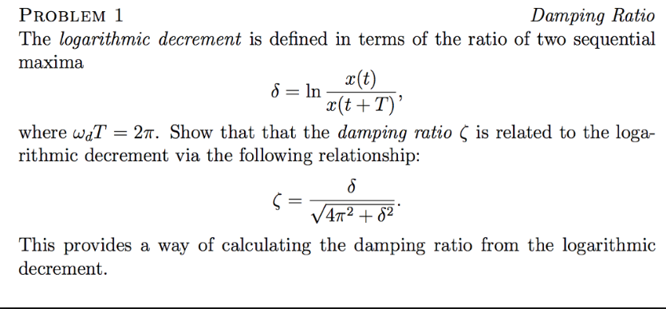
Example 3
Notes:
https://www.chegg.com/homework-help/questions-and-answers/damping-ratio-problem-1-logarithmic-decrement-defined-terms-ratio-two-sequential-maxima-t--q26849775

Slide 22
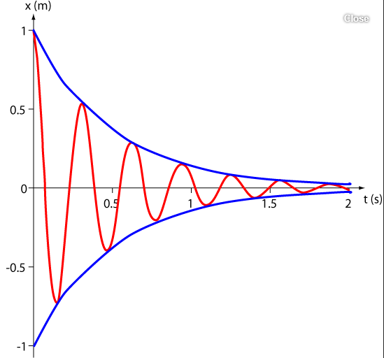
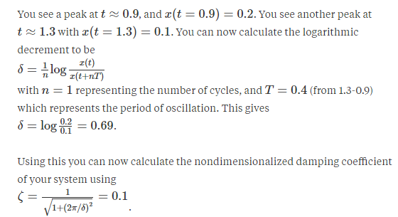
Example 2
Determination of logarithmic decrement
Damping ratio
https://www.quora.com/What-is-the-use-of-logarithmic-decrement

Slide 23
Relaxation time
This expresses the damping effect on the motion in terms of the time taken by the amplitude to decrease by a factor of ((1/e) = 0.368) of its original amplitude; e = 2.718.
The relaxation time or modulus of decay is denoted as τ.
From the expression
The relaxation time is a measure of how rapidly the motion is damped out by friction. The higher the value of r, the shorter the relaxation time.

Slide 24
Quality Factor or Q-Value (1)
The reduction of the total energy of the damped oscillator depends on the exponential decay factor given by
The time for the energy E to decay to E₀e⁻¹ is given by t = m/r.
During this time the oscillator will have vibrated through .
The ratio is defined as the quality factor .
This expresses the number of radians through which the damped system oscillates as its energy decays to E₀e⁻¹

Slide 25
Quality Factor or Q-Value (2)
The rate of energy loss is given as dE/dt where E = E₀exp(=rt/m).
If a time interval corresponding to the energy decay is given by t’ (equivalent to the period of oscillation), the energy loss becomes -ΔE = (dE/dt)t’.
Because dE/dt = (-r/m)E₀e^{-rt/m} and
This leads to
In summary, Q is a measure of the rate at which an oscillator loses energy.

Slide 26


